Slide 1
FOUNDATION COURSE NGO VISIT

Slide 3
SEEING THESE KIDS HAPPY
WAS THE BEST FEELING IN
THE WORLD

Slide 4
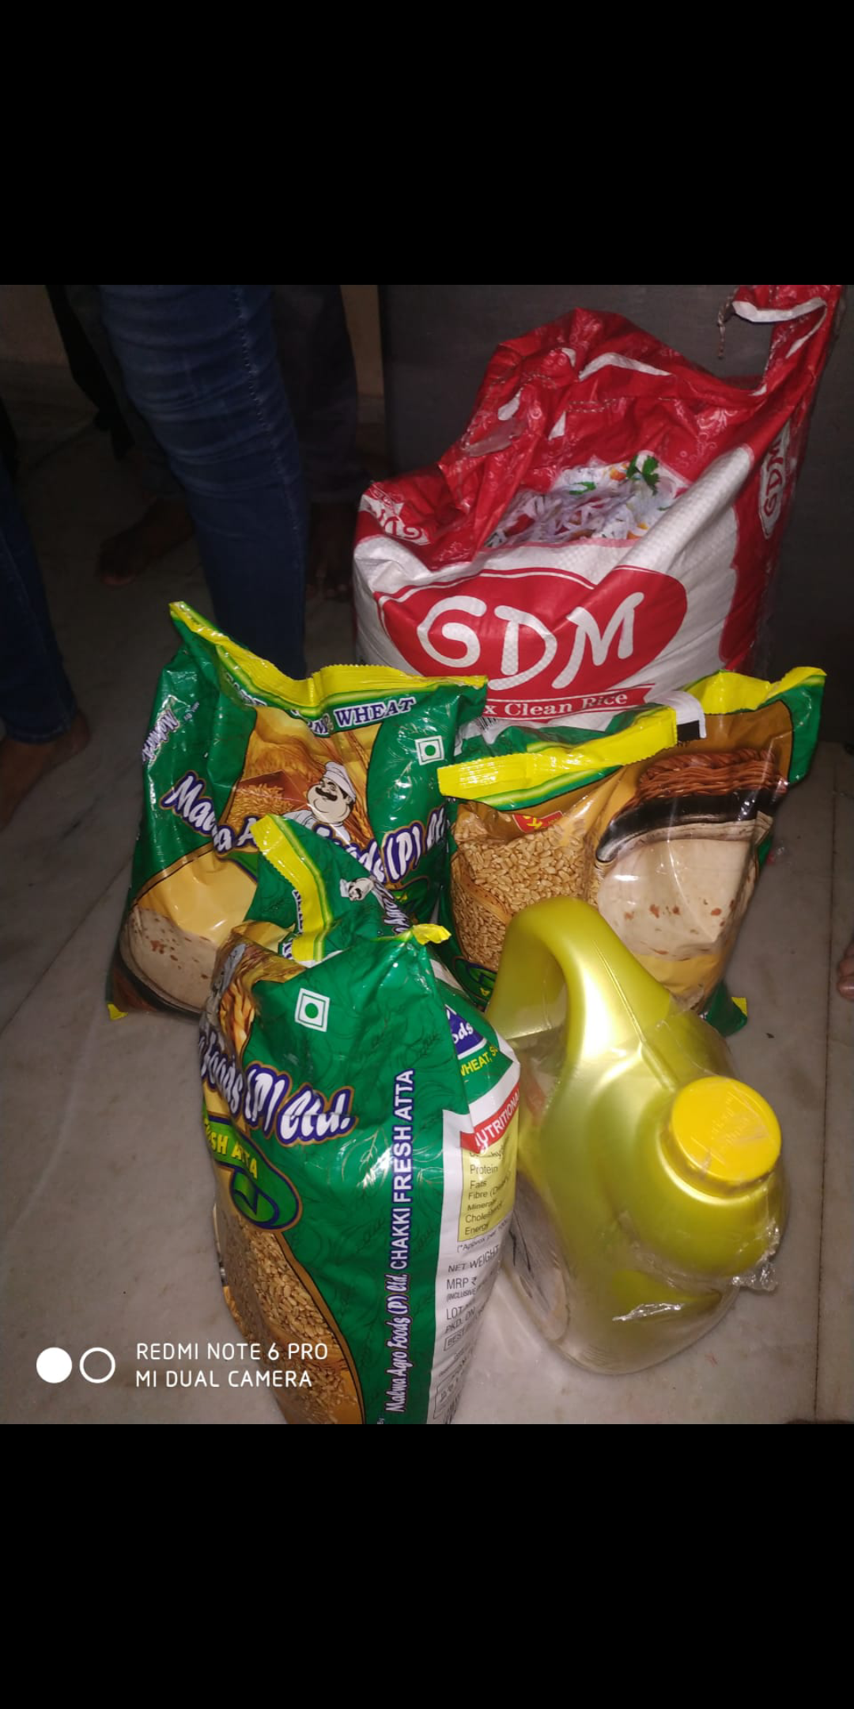
BEFORE YOU COMPLAIN ABOUT THE TASTE OF YOUR FOOD,
THINK OF SOMEONE WHO HAS NOTHING TO EAT

Slide 5
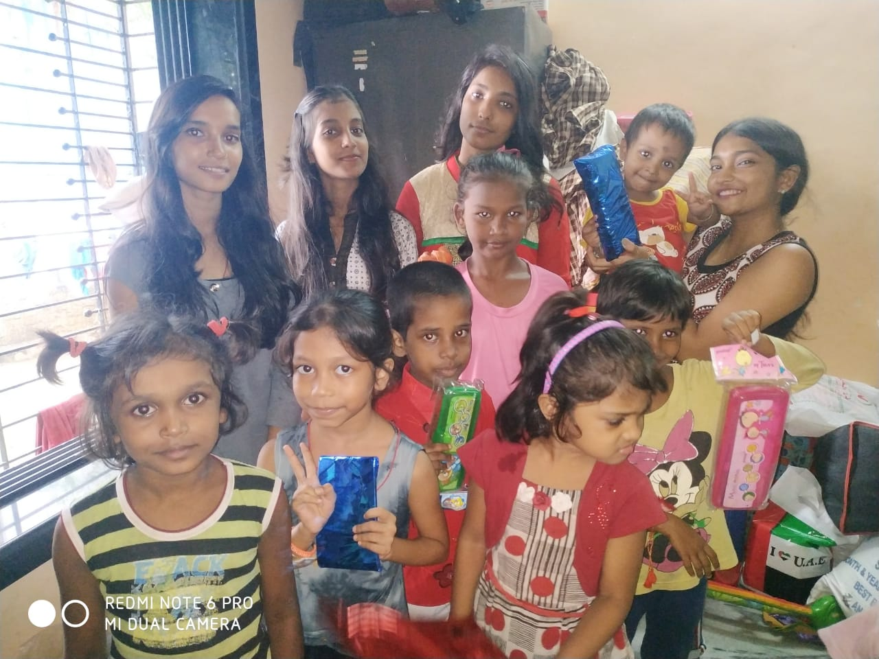
BE THE REASON
BEHIND
SOMEONE’S SMILE

Slide 6
WAS A FUN TO SPEND SOME TIME WITH THESE KIDS

Slide 7
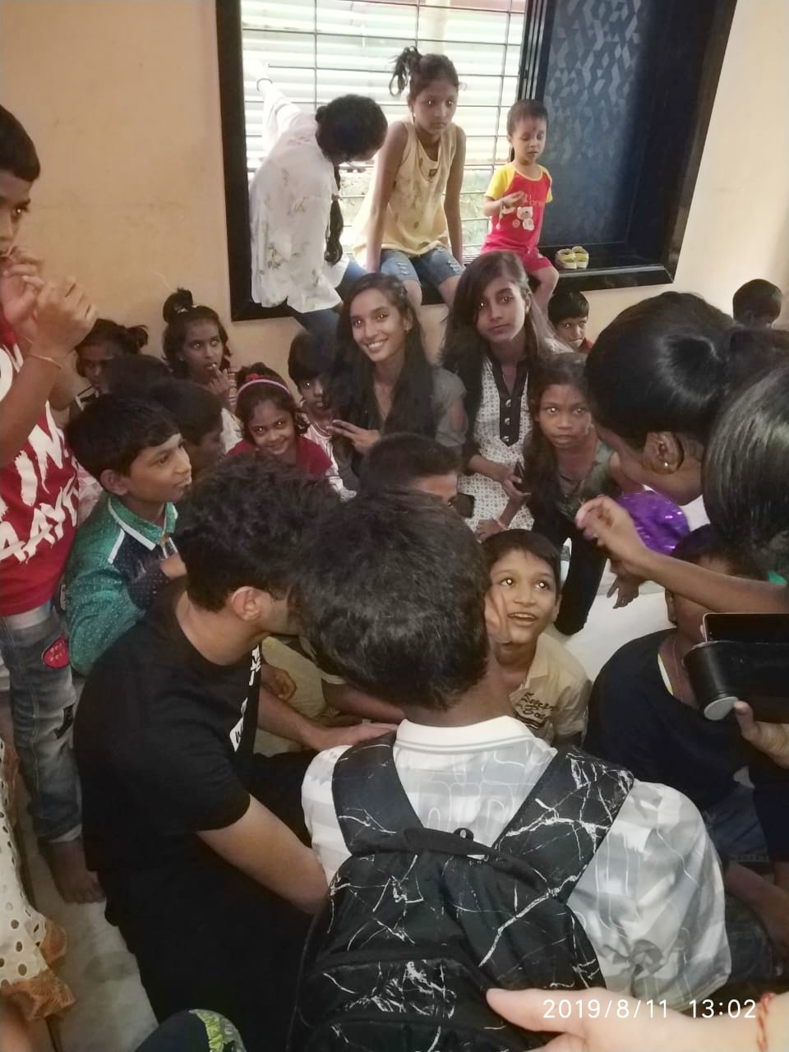

Slide 9
NO ONE CAN HELP EVERYONE BUT EVERYONE CAN HELP SOMEONE

Slide 10
GROUP MEMBERS
SIDDHI
MAITREE
REBECCA
ARCHANA
DIKSHITA
AFREEN
SEJAL
NEHA
NIDHI
MANAV
APURVa

Slide 11
THANKYOU
-DIV A

